Slide 1

ngular 2 Training
Day 1
Roopesh Kumar

Slide 2
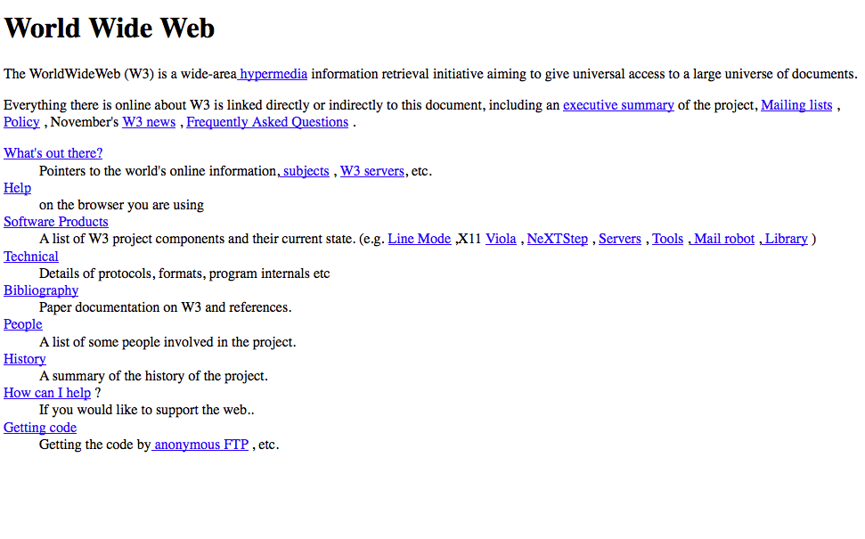
History of HTML
In 1980, physicist Tim Berners-Lee, a contractor at CERN, proposed and prototyped ENQUIRE, a system for CERN researchers to use and share documents.
The first publicly available description of HTML was a document called "HTML Tags", first mentioned on the Internet by Tim Berners-Lee in late 1991
http://info.cern.ch/

Slide 3
ngular 2
Angular is a framework for building client applications.
Language support : JavaScript, Dart or TypeScript.
Completely new stack written on TypeScript.
3-5 times faster as compared to Angular 1.
Controller and scope used in Angular 1 is deprecated in Angular 2.

Slide 4
Angular Architecture
Modules
Components
Templates
Metadata
Data Binding
Directives
Services
Dependency Injection

Slide 5
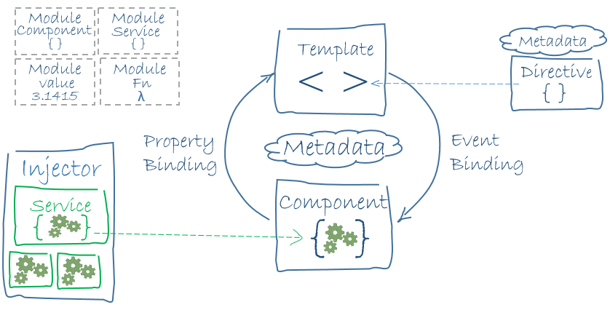
Block Diagram

Slide 6
Module
Cohesive block of components, directives, services and pipes.
Type : Root Module, Feature Module.
Decorator: @NgModule
Properties (Metadata):
declarations - the view classes that belong to this module. Angular has three kinds of view classes: components, directives, and pipes.
exports - the subset of declarations that should be visible and usable in the component templates of other modules.
imports - other modules whose exported classes are needed by component templates declared in this module.
providers - creators of services that this module contributes to the global collection of services; they become accessible in all parts of the app.
bootstrap - the main application view, called the root component, that hosts all other app views. Only the root module should set this bootstrap property.

Slide 7
Root Module
Movies
Feature Module
Interviews
New Releases
Events
Application Module
Movies List
Movie Details

Slide 8
Components
A component controls a patch of screen called a view.
Decorator: @Component
Properties (Metadata):
selector: CSS selector that tells Angular to create and insert an instance of this component where it finds given tag in parent HTML.
templateUrl: module-relative address of this component's HTML template.
styleUrl: module-relative address of this component's style sheet.
providers: array of dependency injection providers for services that the component requires.

Slide 9
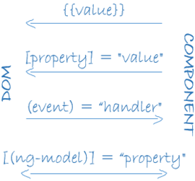
Data Binding

Slide 10
Directives
Component – directive with template.
Structural directives – change the DOM layout by adding and removing DOM elements. Eg – NgFor, NgIf
Attribute directives – change the appearance and behavior of an element. Eg – NgStyle

